Slide 1
AI-assisted sentiment analysis
Mikko Mononen / Steamdata
for BearIT ICT Camp (Tampere, 21.8.2024 - 15.10.2024)

Slide 2
Harvesting sentiments from player reviews
Goals
Exploring the tools and the methods
Documenting the process
Designing a viable user research tool
Analysis
Information
Data
Theoretical and domain knowledge
LLM
Prompt

Slide 3
Basic workflow
Data Engineering
Choose a game and request Steam API for the 20 most helpful reviews to analyze.
1
Prompt Engineering
Iterate the prompt with Ollama - a local LLM server, your chosen language model for the task - Gemma 2 in this project, and Docker contained Open WebUI.
2
Sentiment Analysis
Go through the list of games in Python with an Ollama-hosted language model and save the sentiment analysis in a local database.
3
Second Pass Analysis
Create an overall sentiment analysis over the local sentiment database in Python with Ollama and LLM. Simplify further and unify synonyms.
4
Data Visualization
Visualize data to tell your story.
5

Slide 4
For game designers and researchers

Slide 5
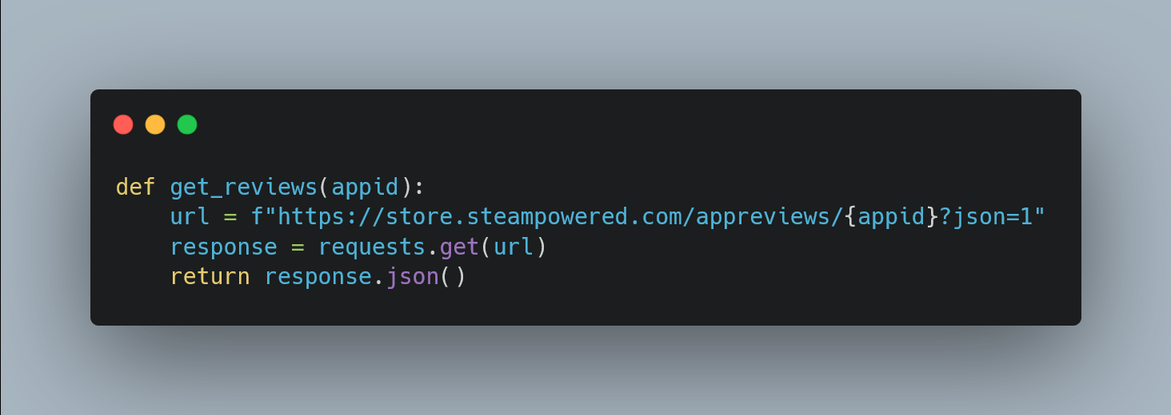
Using Steam API to get the most helpful reviews

Slide 6
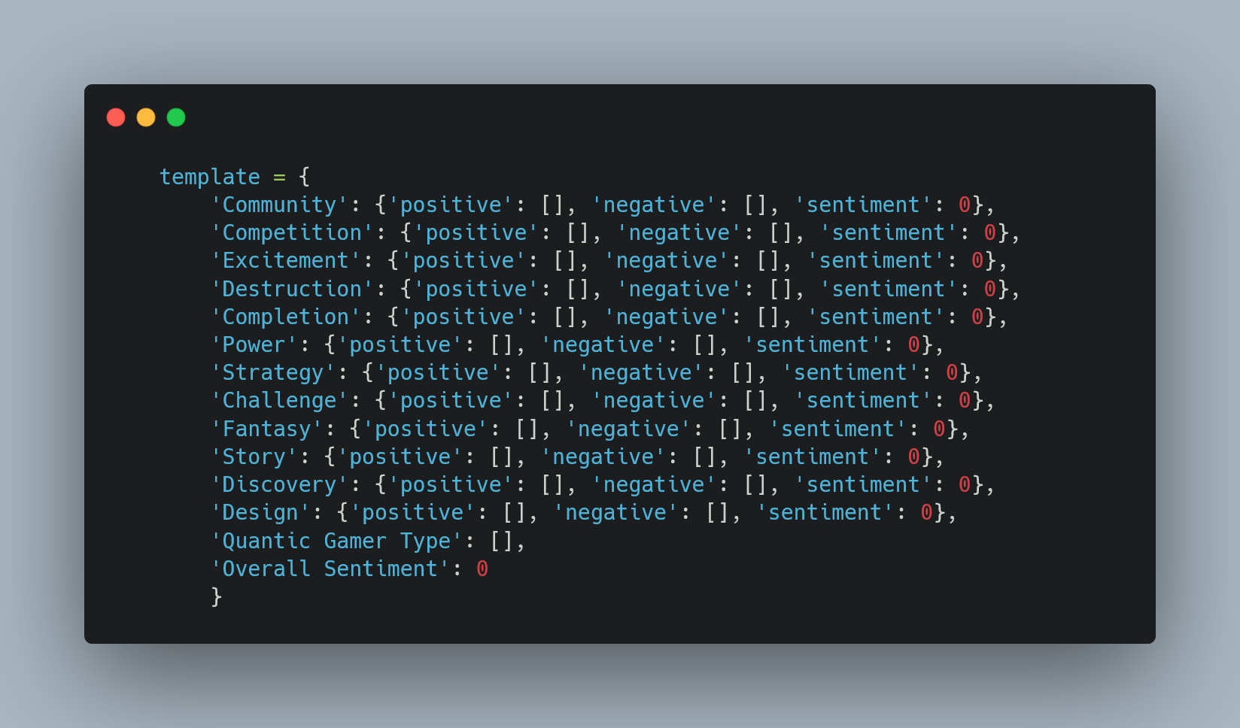
Quantic Player Type data template for LLM to fill during semantic analysis

Slide 7
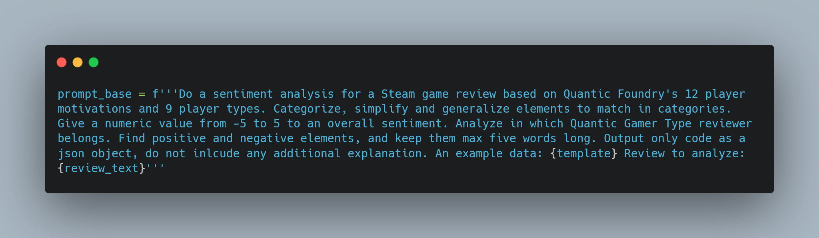
LLM prompt after many iterations

Slide 8
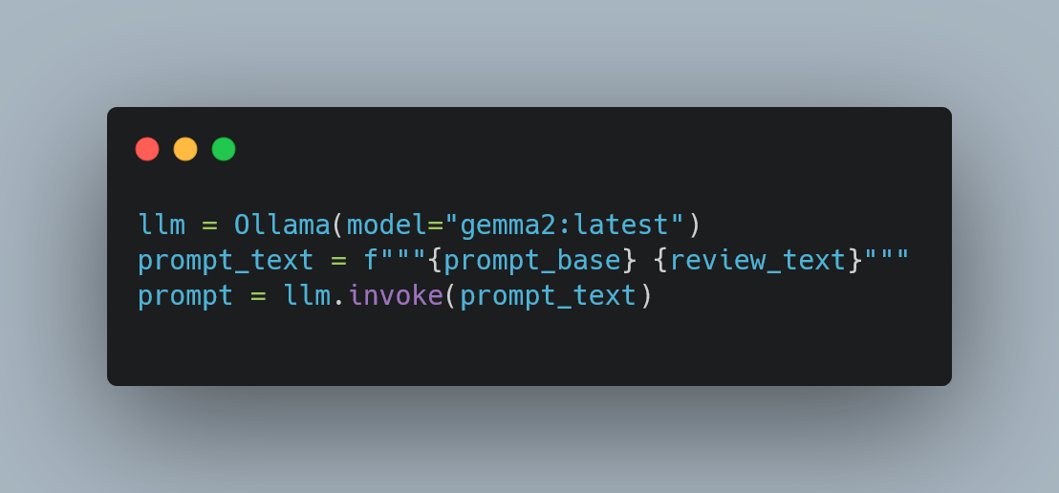
Initializing and invoking LLM with the Ollama server

Slide 9
Categories from Quantic Foundry’s Gamer Motivation Model
"[Review ID]": {
"Excitement": {
"positive": [
"fantastic",
"potential"
],
"negative": [],
"sentiment": 2
},
"Completion": {
"positive": [],
"negative": [
"bugs",
"needs time"
],
"sentiment": -1
},
"Strategy": {
"positive": [
"economy feels better"
],
"negative": [
"population growth",
"slower simulation"
],
"sentiment": -1
},
"Challenge": {
"positive": [
"can be fixed"
],
"negative": [],
"sentiment": 1
},
"Design": {
"positive": [
"great at first",
"upgrades fantastic"
],
"negative": [],
"sentiment": 2
},
"Quantic Gamer Type": [
"Completionist",
"Challenger"
],
"Overall Sentiment": 0
},

Slide 10
Cities: Skylines II
"unfortunately I can not recommend this game. its great at first, all the upgrades from skylines 1 are fantastic. its plays well until it doesn't. population growth is rewarded with slower simulation speeds. this game has a ton of potential if this can be fixed. 7800x3d, 4070,"
economy feels better upgrades fantastic
bugs needs time
Gamer Type: Completionist, Challenger
Overall Sentiment: 0 (-5 to 5)

Slide 11
For game developers and analysts

Slide 12
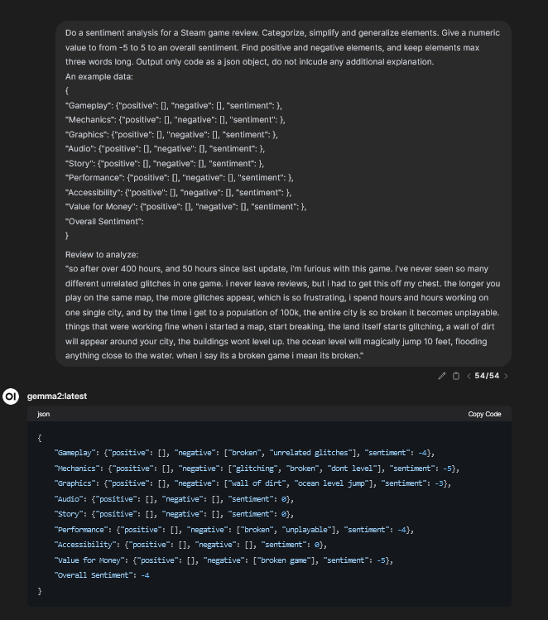
Prompt engineering with Gemma 2 in Open WebUI
Going through prompt iteration #54

Slide 13
Categories via domain knowledge
"[Review ID]": {
"Gameplay": {
"positive": [
"fun game"
],
"negative": [
"game breaking bugs",
"odd design",
"sterile",
"overly clean"
],
"sentiment": -1
},
"Mechanics": {
"positive": [
"feels better",
"good economy"
],
"negative": [],
"sentiment": 1
},
"Graphics": {
"positive": [
"good looking"
],
"negative": [],
"sentiment": 1
},
"Performance": {
"positive": [],
"negative": [
"high end",
"misread audience"
],
"sentiment": -2
},
"Overall Sentiment": -1

Slide 14
Cities: Skylines II
"Colossal Order please re watch your own promotion video from 5 years ago by Justin Roczniak/donoteat01 and listen to what he says. That's what a good city simulation needs to be able to do, on top of being a good looking city painter. Its a start but still has some odd design. I think the worst part is somehow its more sterile and overly clean felling than the first game. Shame on Paradox for pushing this out the door long before it was ready. Making hardware requirements this high end was a fundamental misread of your audience. City builders are traditionally played on mid range systems and laptops and by people who often don't prioritize cutting edge first person shooter/ action game graphics."
Gameplay:
fun game
game breaking bugs
odd design
sterile
overly clean
Sentiment: -1
Mechanics:
feels better
good economy
Sentiment: 1
Graphics:
good looking
Sentiment: 1
Performance:
high end
misread audience
Sentiment: -2
Overall:
Sentiment: -1

Slide 15
Cities: Skylines II - Overall Sentiments
Category
Positive
Negative
Recurring positive and negative themes
1
Gameplay (0.67)
20
19
Fun game
Mixed-zoning
Road-building
Game breaking bugs
Sterile design
Boring
2
Mechanics (-0.07)
18
13
Economy
Zone mixing
New mechanics
Bugs
Crashes
Lacks polish
3
Graphics (-0.2)
2
11
Good looking
Realistic art
Lacks polish
Glitches
Dull colors
4
Value for money (-1.15)
0
7
Don’t buy
Lack of content
Wait until 2026
5
Performance (-2.0)
0
23
Bugs
Glitches
Crashes

Slide 16
Results

Slide 17
Results may vary
Subtle changes
Subtle changes to the prompt allow tailoring analysis to exact inspection points in different use cases, e.g., performance and technical issues.
Keeping the full review available
LLMs might get contexts wrong or start hallucinating.
Exact prompts
As a rule of thumb, the more precision, the better.
Better accuracy at a general level
Accuracy gets worse at the individual review level. Smart categories help to get the best results.

Slide 18
Remarks

Slide 19
Future development
Refactor code before open-sourcing
Create and fine-tune premade prompts for different use cases
Incorporate seamlessly analytical and visualizing tools
Combine everything as a Docker container for better usability and compatibility
Add to portfolio

Slide 20
Thank you!
Questions?
End of transmission. ␄

